Slide 1
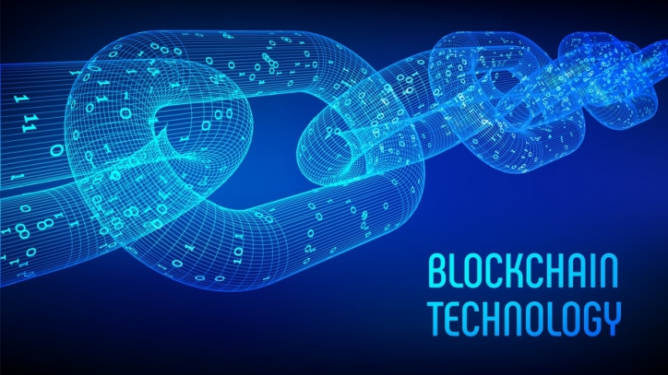

Blockchain Accident

Slide 2

Project Team
Burak Konca (Project Leader)
Ozan Aksakal
Maral Mousawi
Julian Bedöcs

Slide 3

Idea
Application for the forgery-proof creation of accident reports with a blockchain
The identification of the accident participants and the vehicles involved should be secured
Data stored anonymously
Midterm Project (2 Sem)

Slide 4
Realization
Programming Language: Solidity
Blockchain:
Ethereum-chain
Framework:
Truffle Suite
Local testing: Ganache
Crypo Wallet & Access to Blockchain Apps:
Metamask
Storing:
IPFS
Website:
HTML/CSS, PHP, JS

Slide 5
Planning
Project application
Rough planning
Project goals
Distribution of tasks
Planned project flow
Project environment analysis
Risk analysis
Project resources
Project management process: Scrum
Status reports
Project structure plan

Slide 6
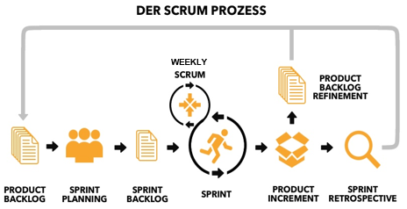
Project management process: Scrum

Slide 7
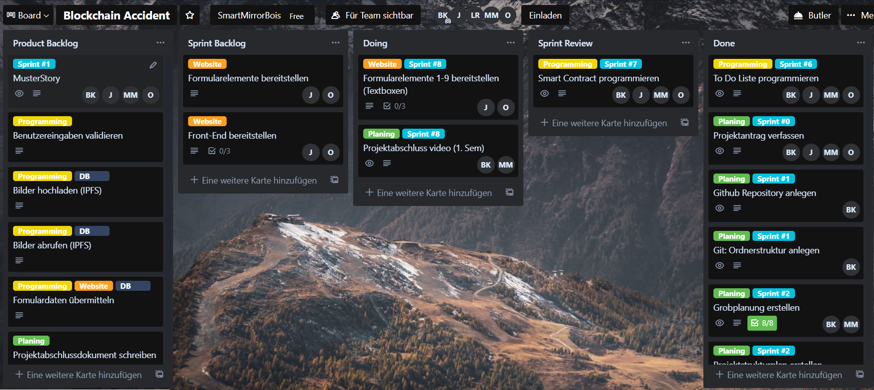
Project management process: Trello

Slide 8
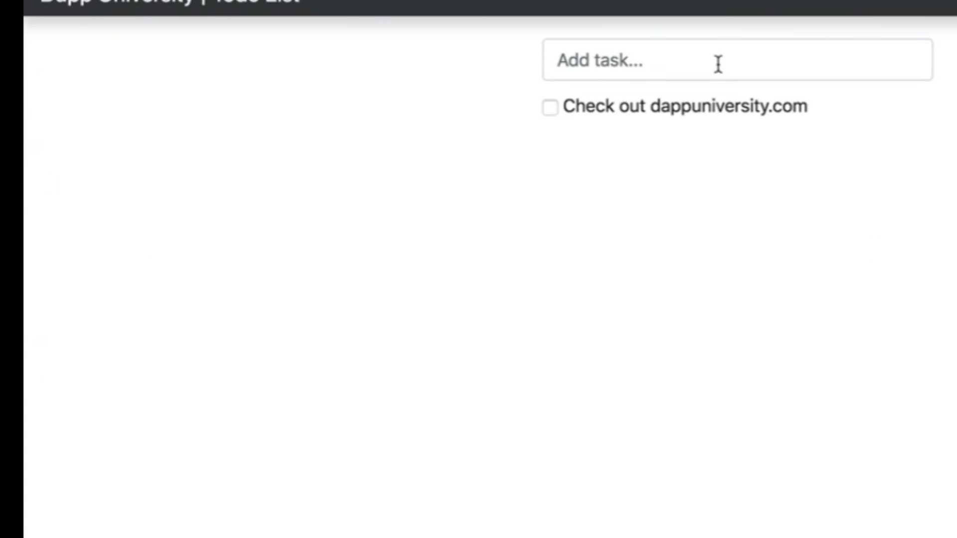
Practice: To do List

Slide 9
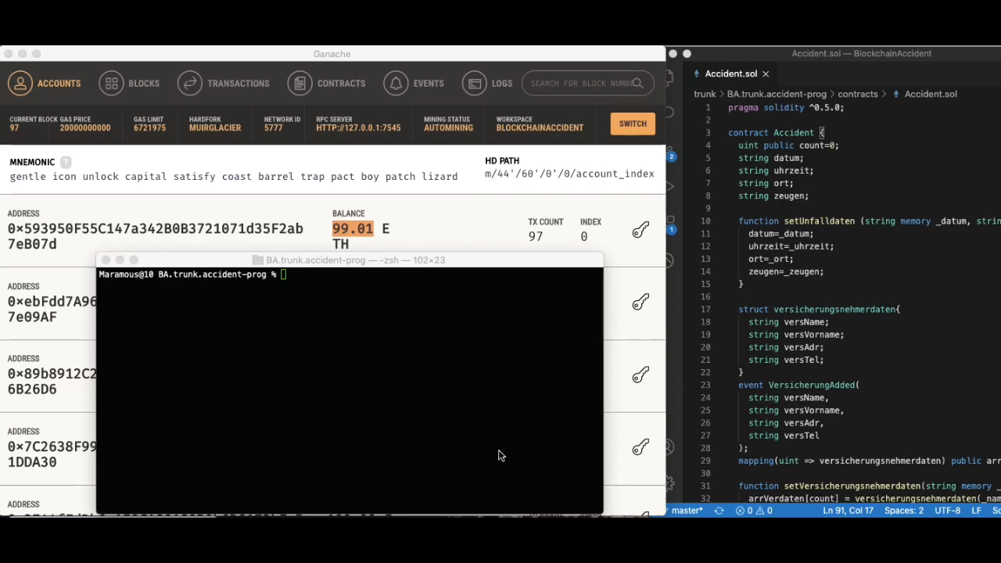
Current status (1) - Backend

Slide 10
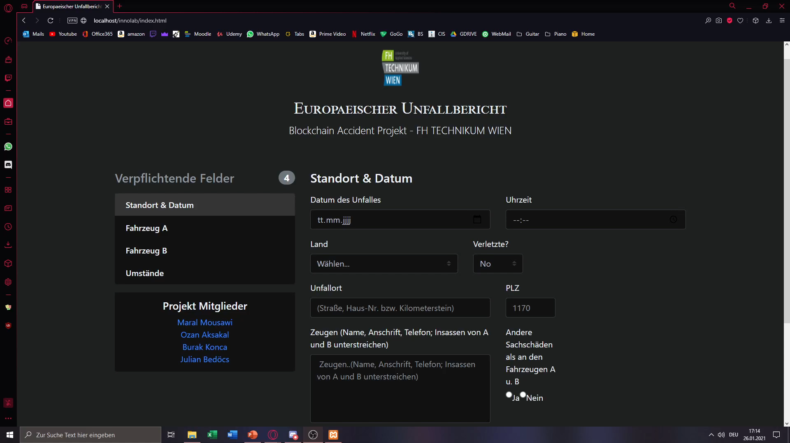
Current Status (2) - Frontend

Slide 11
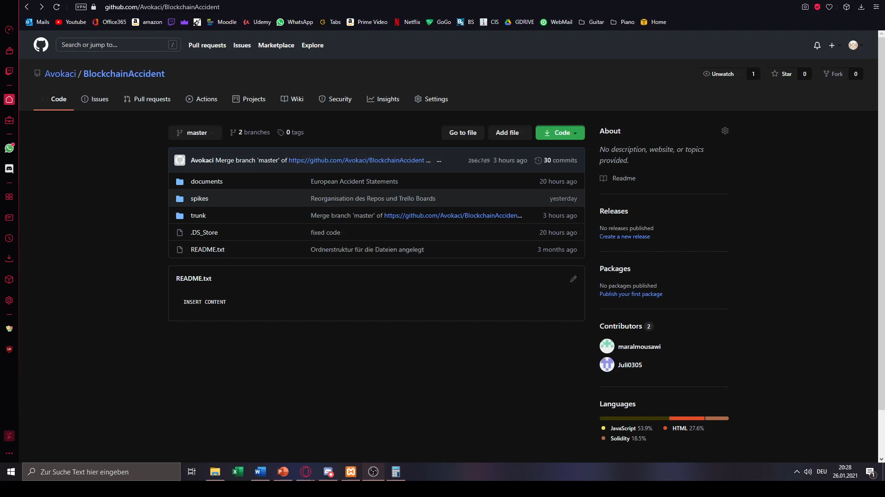
Thank you for you attention!
Link to Github: https://github.com/Avokaci/BlockchainAccident

